Slide 1
Basic Linux

Slide 2
What is the shell
If you’ve ever had to deal with large amounts of data or large numbers of digital files scattered across your computer or a remote server, you know that copying, moving, renaming, counting, searching through, or otherwise processing those files manually can be immensely time-consuming and error-prone. Fortunately, there is an extraordinarily powerful and flexible tool designed for just that purpose.
It is the definitive example of a “command line interface”, where instructions are given to the computer by typing in commands, and the computer responds by performing a task or generating an output. This output is often directed to the screen, but can be directed to a file, or even to other commands, creating powerful chains of actions with very little effort.

Slide 3
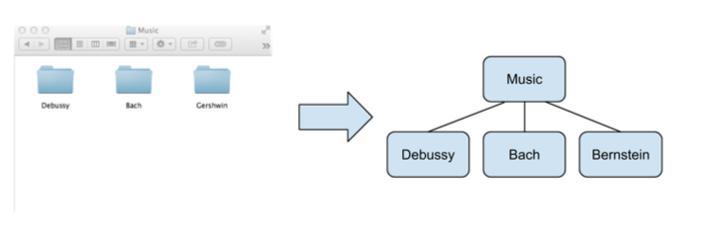
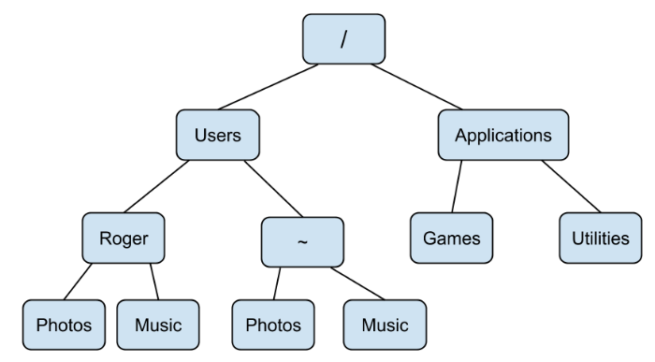
Navigating the Command Line
Computers are organized in a hierarchy of folders, where a folder can contain many folders and files. People who use Linux often refer to folders as directories and these terms are interchangeable. This directory hierarchy forms a tree, as shown in the diagram.
You can use the command line to navigate these trees on your computer.
There are a few special directories that you should be aware of on your computer. The directory at the top of this tree is called the root directory. The root directory contains all other directories, and is represented by a slash (/).
The home directory is another special directory that is represented by a tilde (∼).
When you first open up your shell you usually start off in your home directory.
Notes:
Set your working directory to the root directory.
Set your working directory to your home directory
using three different commands.
Find a folder on your computer using your file and
folder browser, and then set your working directory to
that folder using the terminal.
List all of the files and folders in the directory you
navigated to in #3.

Slide 4
Creation and Inspection
Now that you can fluidly use your terminal to bound between directories all over your computer I’ll show you some actions you can perform on folders and files.
Commands
mkdir: You can make a directory with the mkdir command, followed by the path to the new directory.
$ mkdir new_folder
touch: most simple way to create a blank file, followed by the path to the file you want to create.
$ touch new_file.txt
wc: use wc to view the word count and other information.
$ wc -lwc new_file.txt -l for lines, -w for words, -c for chars
Notes:
Create a new directory called workbench in your home directory.
Without changing directories create a file called readme.txt inside of workbench.
Append the numbers 1, 2, and 3 to readme.txt so that each number appears on it’s own line.
Print readme.txt to the command line.
Use output redirection to create a new file in the workbench directory called list.txt which lists the files and folders in your home directory.
Find out how many characters are in list.txt without opening the file or printing it to the command line.

Slide 5
Creation and Inspection
Now that you can fluidly use your terminal to bound between directories all over your computer I’ll show you some actions you can perform on folders and files.
Commands
cat: use cat command to print file in console. This command really means to concatenate files.
$ cat new_file.txt new_file.txt
Output redirection (>) & (>>): one easy way to create a file is using output redirection.
$ echo "hello world" > new_file.txt $ echo "hello world" >> new_file.txt
head & tail: glimpsing the start and end of the file.
$ head new_file.txt $ tail new_file.txt
Notes:
Create a new directory called workbench in your home directory.
Without changing directories create a file called readme.txt inside of workbench.
Append the numbers 1, 2, and 3 to readme.txt so that each number appears on it’s own line.
Print readme.txt to the command line.
Use output redirection to create a new file in the workbench directory called list.txt which lists the files and folders in your home directory.
Find out how many characters are in list.txt without opening the file or printing it to the command line.

Slide 6
Migration and Destruction
In this section we’ll discuss moving, renaming, copying, and deleting files and folders.
Commands
mv: we can move files and folders using mv command. It takes two arguments: first path of file or folder you want to move, second destination folder. It is also used to rename files and folders.
To move: $ mv my_file.txt destination To rename: $ mv my_file.txt new_name.txt
cp: this command copies files and folders from one location to another. It is used similar to mv command.
To copy: $ cp my_file.txt destination
Notes:
Create a file called message.txt in your home directory and move it into another directory.
Copy the message.txt you just moved into your home directory.
Delete both copies of message.txt. Try to do this without using rm.

Slide 7
Migration and Destruction
In this section we’ll discuss moving, renaming, copying, and deleting files and folders.
Commands
rm: use rm to remove files or folders. rm only require path of file/directory.
To remove file: $ rm destination/my_file.txt To remove folder: $ rm -r destination
To remove directory, we add -r option which is short for recursive.
Notes:
Create a file called message.txt in your home directory and move it into another directory.
Copy the message.txt you just moved into your home directory.
Delete both copies of message.txt. Try to do this without using rm.

Slide 8
Search
The ability to search through files and folders can greatly improve your productivity using Unix.
Commands
Regular expression: String that define pattern in other strings.
grep: The simplest use of grep requires two arguments: a regular expression and a text file of string to search.
$ grep "x" my_file.txt
Notes:
Create a file called message.txt in your home directory and move it into another directory.
Copy the message.txt you just moved into your home directory.
Delete both copies of message.txt. Try to do this without using rm.

Slide 9
Search
Commands
Metacharacters: Characters that can be used to represent other characters.
egrep: “.” (Period) metacharacter, which represent any character.
Quantifier “+” (plus) which represent one or more occurrence of the proceeding expression, e.g “s+as” means: one or more s followed by as.
“*” (star) zero or more occurrence of the proceeding expression.
You can specify occurrence beyond plus or star metacharacters by using curly brackets ({ }) to specify exact number of occurrence. To search for multiple number of occurrence we can specify that using comma in curly bracket.
Notes:
Create a file called message.txt in your home directory and move it into another directory.
Copy the message.txt you just moved into your home directory.
Delete both copies of message.txt. Try to do this without using rm.

Slide 10
Search
Commands
Metacharacters:
We can use capturing group to capture multiple occurence of a string using parentheses("( )").
period(.): $ egrep "i.g" my_file.txt
plus(+): $ egrep "s+as" my_file.txt
star(*): $ egrep "s*as" my_file.txt
bracket({})single: $ egrep "s{2}" my_file.txt multiple: $ egrep "s{2,3}" my_file.txt
capturing group ("( )"): $ egrep "(iss){2}" my_file.txt
Notes:
Create a file called message.txt in your home directory and move it into another directory.
Copy the message.txt you just moved into your home directory.
Delete both copies of message.txt. Try to do this without using rm.

Slide 11
Pipes
One of the most powerful features of the command line is skilled use of the pipe (|). The pipe allows us to take the output of a command, which would normally be printed to the console, and use it as the input to another command.
Commands
Pipes can be used with multiple bash commands.
printing just 5 starting lines of a file:
$ cat my_file.txt | head -n 5
printing no of lines after applying regex on file:
$ grep "x" my_file.txt | wc -l
list files and folder then applying regex and then printing last few lies:
$ ls -la | grep "FEB" | less
Notes:
Use pipe in 2 to 3 commands of your own.

Slide 12
Crontab in Linux
What is Cron Job?
Cron is a scheduling daemon that executes tasks at specified intervals. These tasks are called cron jobs and are mostly used to automate system maintenance or administration.
Why do we use Cron Job?
Helps OS to take a scheduled backup of log files or database.
Delete old log files
Archive and purge database tables
Send out any notification email such as Newsletters, Password expiration email
Regular clean-up of cached data
Crontab is an ideal option to automate Unix jobs.
It is used to automate system maintenance

Slide 13
Crontab in Linux
What is crontab file?
Crontab (cron table) is a text file that specifies the schedule of cron jobs. There are two types of crontab files. The system-wide crontab files and individual user crontab files.
Although you can edit the user crontab files manually, it is recommended to use the crontab command.
The /etc/crontab file and the scripts inside the /etc/cron.d directory are system-wide crontab files that can be edited only by the system administrators.

Slide 14
Crontab in Linux
Crontab Syntax and Operators
Each line in the user crontab file contains six fields separated by a space followed by the command to be run.
* * * * * command(s)
| | | | |
| | | | ⳑ---- Day of week (0 - 7) (Sunday=0 or 7)
| | | ⳑ------ Month (1 - 12)
| | ⳑ-------- Day of month (1 - 31)
| ⳑ---------- Hour (0 - 23)
ⳑ------------ Minute (0 - 59)
Predefined Macros
Instead of typing those 5 parameters, we can save time and improve readability by using one of the Predefined Macros:
● @reboot: Run once, at startup
● @yearly: Run once a year, i.e. "0 0 1 1 *".
● @annually: Run once a year, i.e. "0 0 1 1 *".
● @monthly: Run once a month, i.e. "0 0 1 * *".
● @weekly: Run once a week, i.e. "0 0 * * 0".
● @daily: Run once a day, i.e. "0 0 * * *".
● @hourly: Run once an hour, i.e. "0 * * * *".

Slide 15
Crontab in Linux
Crontab Special Characters
The first five fields may contain one or more values, separated by a comma or a range of values separated by a hyphen.
* - The asterisk operator means any value or always. If you have the asterisk symbol in the Hour field, it means the task will be performed each hour.
, - The comma operator allows you to specify a list of values for repetition. For example, if you have 1,3,5 in the Hour field, the task will run at 1 am, 3 am and 5 am.

Slide 16
Crontab in Linux
Crontab Special Characters
The first five fields may contain one or more values, separated by a comma or a range of values separated by a hyphen.
- - The hyphen operator allows you to specify a range of values. If you have 1-5 in the Day of week field, the task will run every weekday (From Monday to Friday).
/ - The slash operator allows you to specify values that will be repeated over a certain interval between them. For example, if you have */4 in the Hour field, it means the action will be performed every four hours. It is same as specifying 0,4,8,12,16,20. Instead of asterisk before the slash operator, you can also use a range of values, 1-30/10 means the same as 1,11,21.

Slide 17
Scheduling Cron jobs: Linux
Linux Crontab Command
The crontab command allows you to install, view, or open a crontab file for editing. The crontab command opens the crontab file using the editor specified by the VISUAL or EDITOR environment variables.
crontab -e - Edit crontab file, or create one if it doesn’t already exist.
crontab -l - Display crontab file contents.
crontab -r - Remove your current crontab file.
crontab -i - Remove your current crontab file with a prompt before removal.
crontab -u <username> - Edit other user crontab file. This option requires system administrator privileges.

Slide 18
Scheduling Cron jobs: Linux
Linux Crontab Command
The crontab command allows you to install, view, or open a crontab file for editing. The crontab command opens the crontab file using the editor specified by the VISUAL or EDITOR environment variables.
Crontab Restrictions
The /etc/cron.deny and /etc/cron.allow files allows you to control which users have access to the crontab command. The files consist of a list of usernames, one user name per line.
By default, only the /etc/cron.deny file exists and is empty, which means that all users can use the crontab command. If you want to deny access to the crontab commands to a specific user, add the username to this file.
If the /etc/cron.allow file exists only the users who are listed in this file can use the crontab command.
If neither of the files exists, only the users with administrative privileges can use the crontab command.

Slide 19
Scheduling Cron jobs: Linux
Cron jobs Examples
The Below are some cron job examples that show how to schedule a task to run on different time periods.[1]
Run a command at 15:00 on every day from Monday through Friday:
Run two commands every Monday at 3PM (use the operator && between the commands):
Run a PHP script every 2 minutes and write the output to a file:
Run the a script at 9:15pm, on the 1st and 15th of every month:
Run a script on the first Monday of each month, at 7 a.m.
0 15 * * 1-5 command
0 15 * * Mon command1 && command2
*/2 * * * * /usr/bin/php /path/to/script.php >> /var/log/script.log
15 9 1,15 * * /path/to/script.sh
0 7 * * 7 [ $(date +\%d) -le 07 ] && /run/your/script
Notes:
https://crontab.guru/

Slide 20
Windows Task Scheduler
What is Task Scheduler?
On Windows 10, Task Scheduler is a tool that allows you to create and run virtually any task automatically. You can start applications, run commands, and execute scripts at a particular day and time, or you can also trigger tasks when a specific event occurs.
Why use Task Scheduler?
Helps OS to take a scheduled backup of log files or database.
Run system tasks such as disk defragmentation, disk cleanup, and updates
Send out any notification email such as Newsletters, Password expiration email
It is used to automate system maintenance

Slide 21
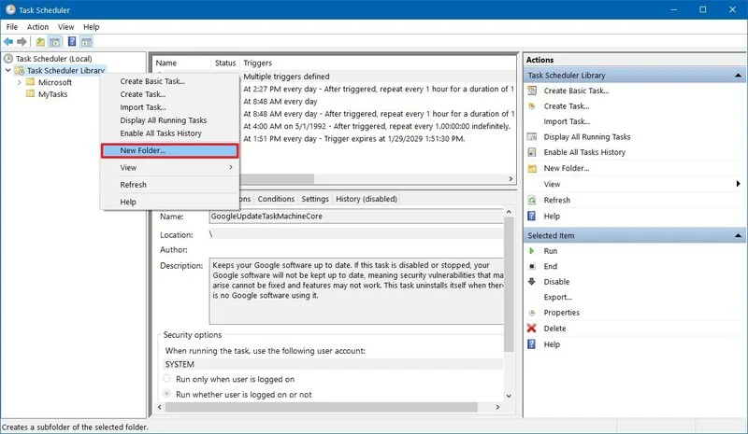
Windows Task Scheduler
Create a basic task using Task Scheduler
To create a task using basic settings on Windows 10, use these steps:
Open Start.
Search for Task Scheduler, and click the top result to open the experience.
Right-click the "Task Scheduler Library" branch, and select the New Folder option.

Slide 22
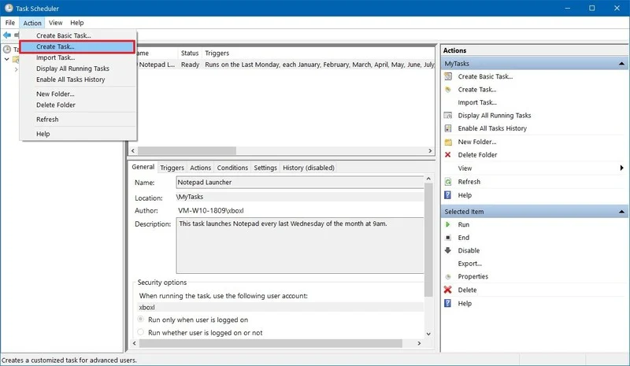
Windows Task Scheduler
Type a name for the folder. For example, MyTasks. (This step isn't a requirement, but it's a recommended step to keep your tasks separate from the system and apps tasks.)
Click the OK button.
Expand the "Task Scheduler Library" branch, and select the MyTasks folder.
Click the Action menu.
Select the Create Task option.

Slide 23
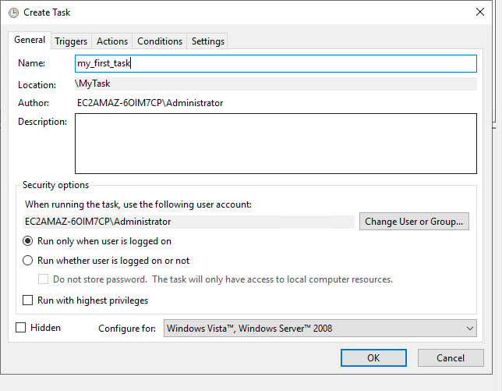
Windows Task Scheduler
In the "Name" field, type a short descriptive name for the task. For example, my_first_task.

Slide 24
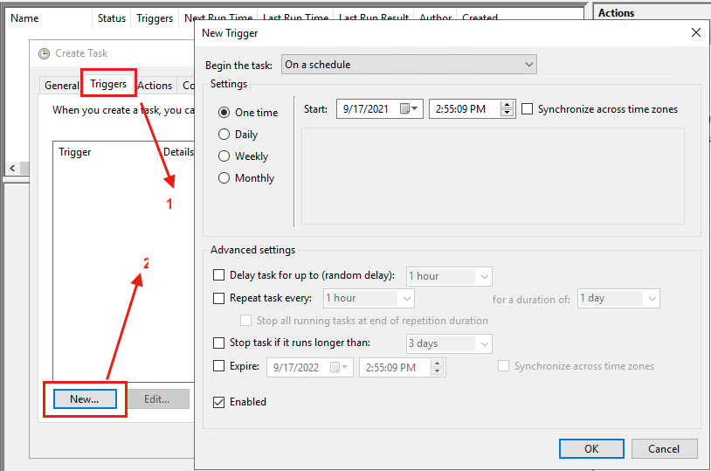
Windows Task Scheduler
Select triggers in create task
Then click on new
Select the Daily option.
Task Scheduler allows you to select from a number of triggers, including on a specific date, during startup, or when you or a particular user signs in.
Depending on your requirements, you'll need to configure additional parameters. In this case, we'll be selecting the option to run a task every month.

Slide 25
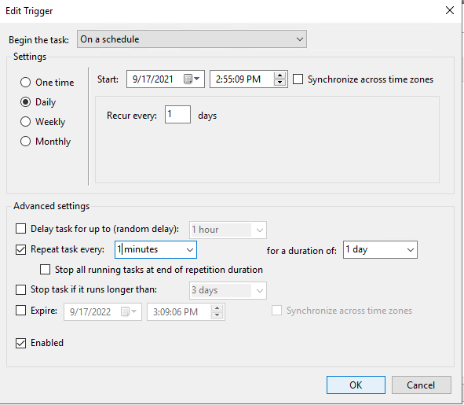
Windows Task Scheduler
In daily option select start date and time.
check repeat task every and enter the repeat duration.
Click OK.

Slide 26
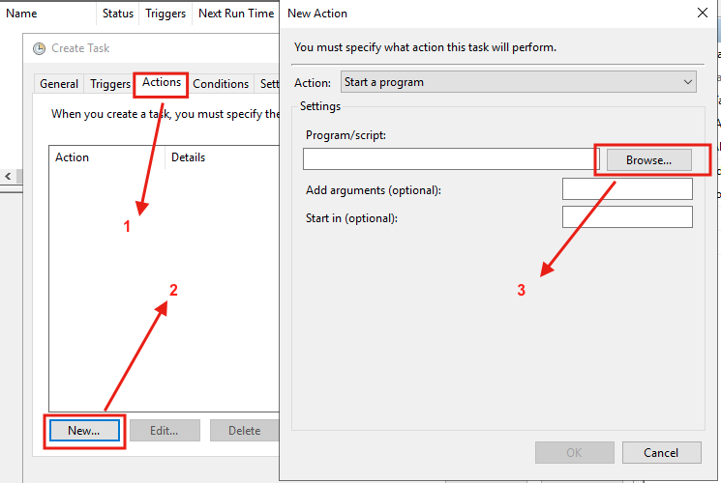
Windows Task Scheduler
Click on Actions tab.
Then click on new… button.
You can browse the path of the program you want to execute.

Slide 27
Windows Task Scheduler
Task 1:
Create a cron job/task scheduler to write results of “get_quotes” into a folder.
Task 2:
Create a simple flask app using python.
Try to trigger that app using gunicorn
Create a cron job (linux/macOS) or Task scheduler (Windows) to automatically run that flask app.

Slide 28
Thanks!
Any questions?
You can find me on Linkedin: @zainkhanln

